Slide 1
Cd8a/b+ cells
stimulation | donorId | count
Microbial | 1_Control | 28
Microbial | 2_T1D | 10
Microbial | 3_Control | 19
Microbial | 4_Control | 11
Microbial | 5_T1D | 138
Microbial | 6_T1D | 82
IAR | 2_T1D | 1
Polyclonal | 2_T1D | 1
Polyclonal | 3_Control | 5
Polyclonal | 4_Control | 4
Polyclonal | 5_T1D | 1
Polyclonal | 6_T1D | 1

Slide 2
Rnaseq clustering after CD8 removal

Slide 3
Celltypist calling and p390 module expression

Slide 4
CD45RA/Ro totalseq

Slide 5
CD45RA vs CD45RO

Slide 6
Cd45ra vs cd45ro, separated by stimulation

Slide 7
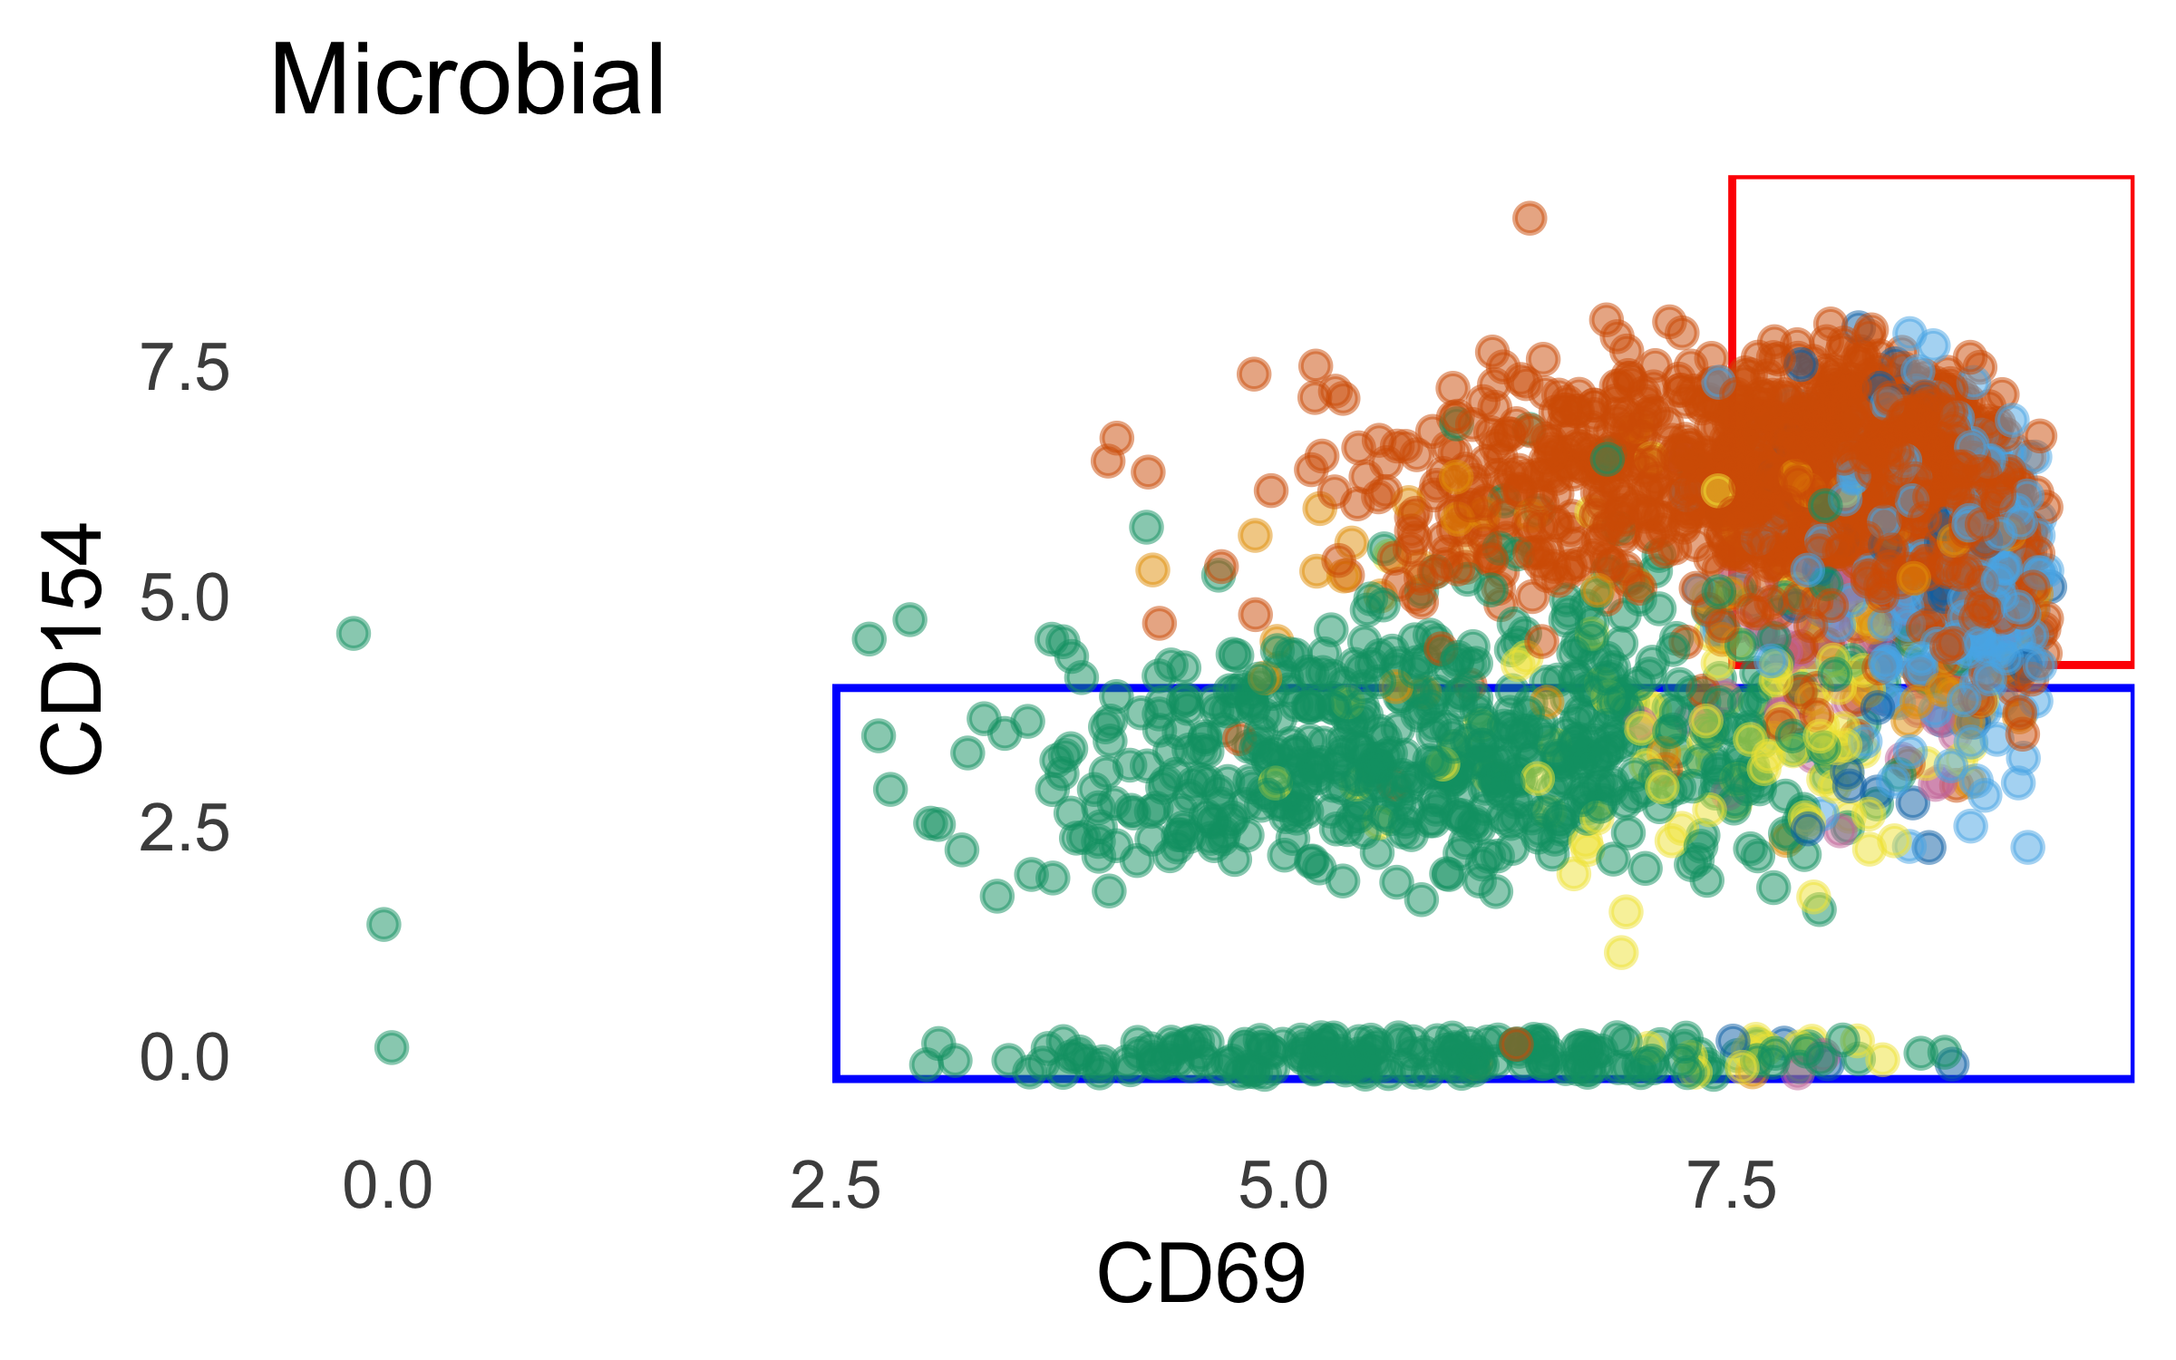
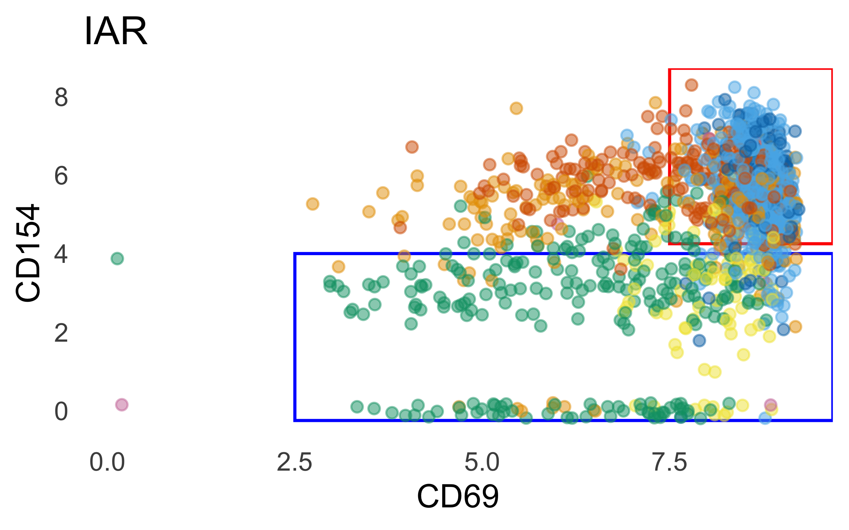
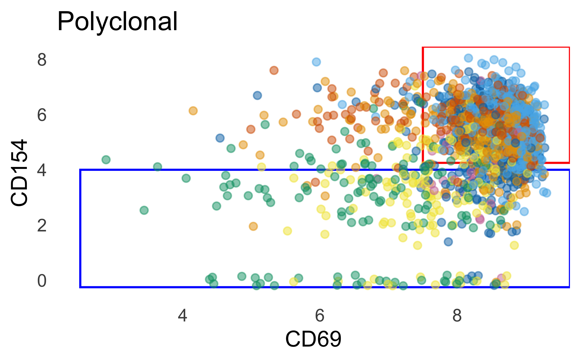
Cd154 vs cd69

Slide 8
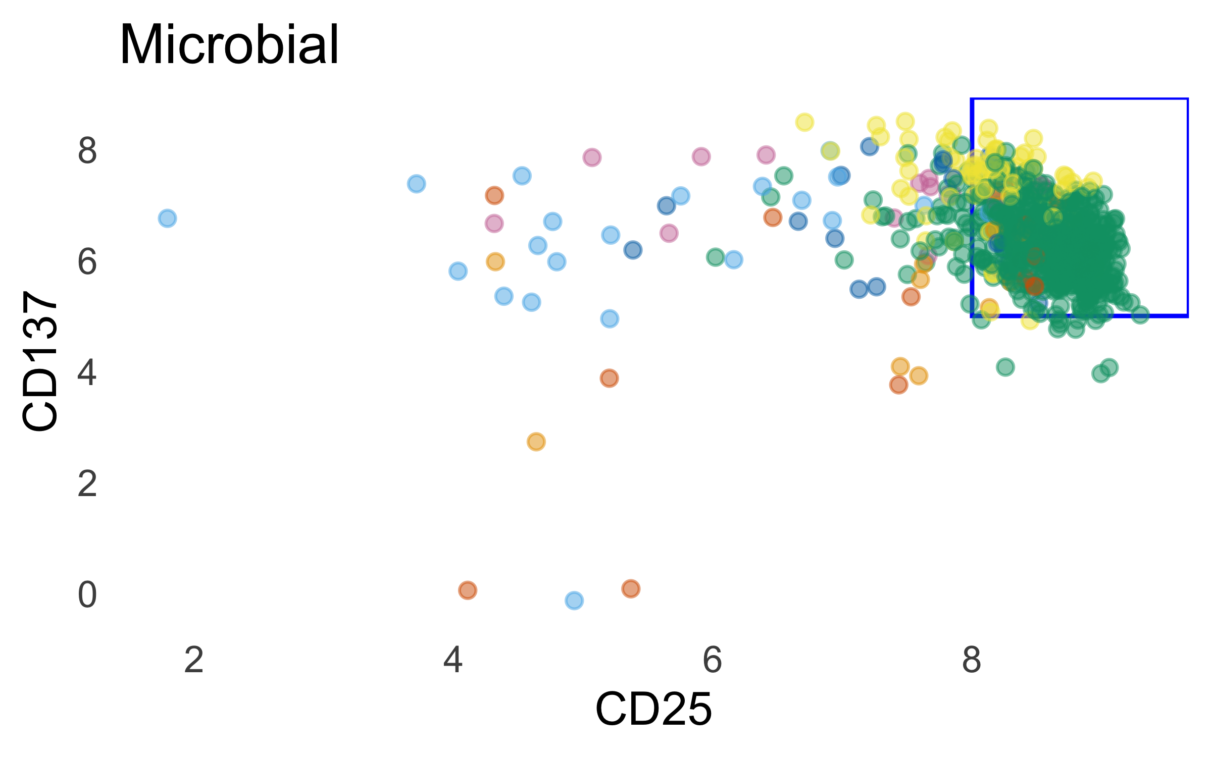
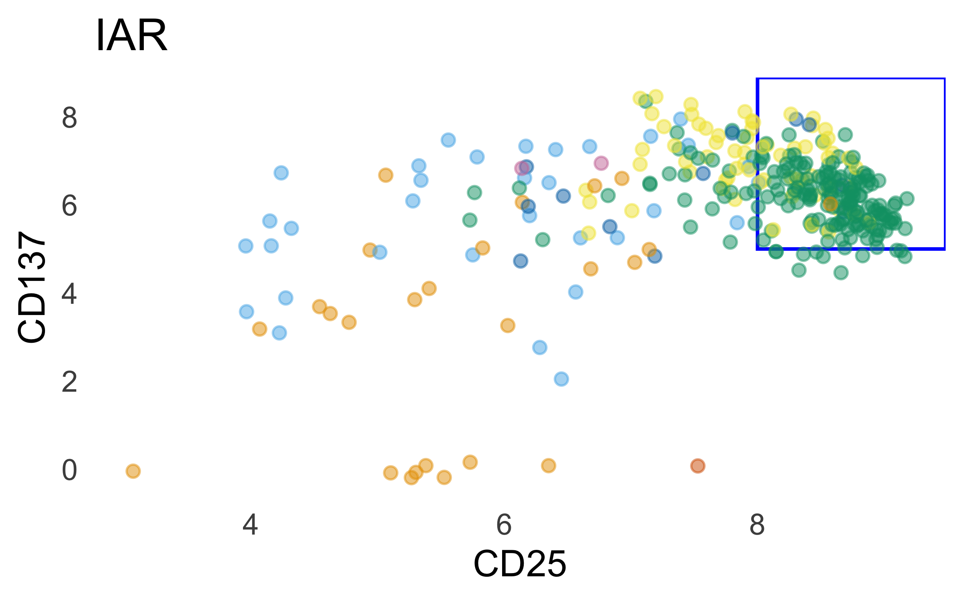
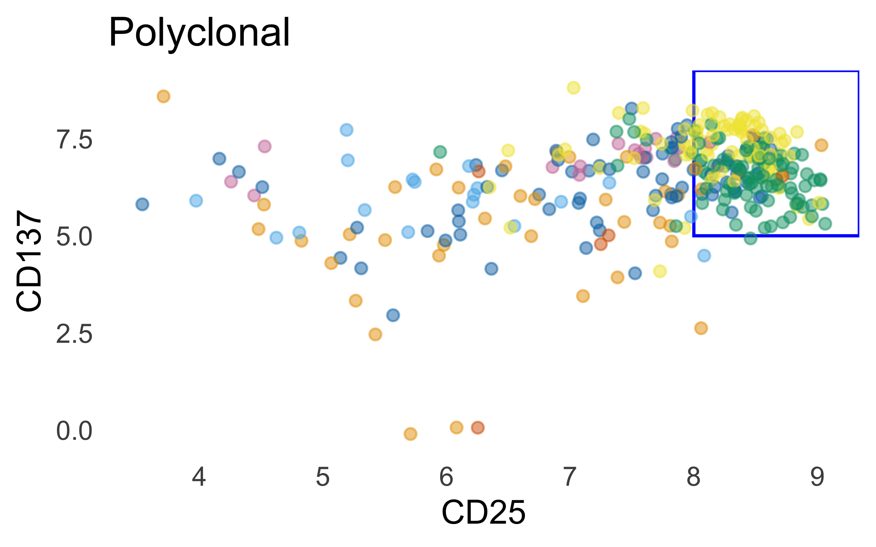
Cd137 vs cd25

Slide 9
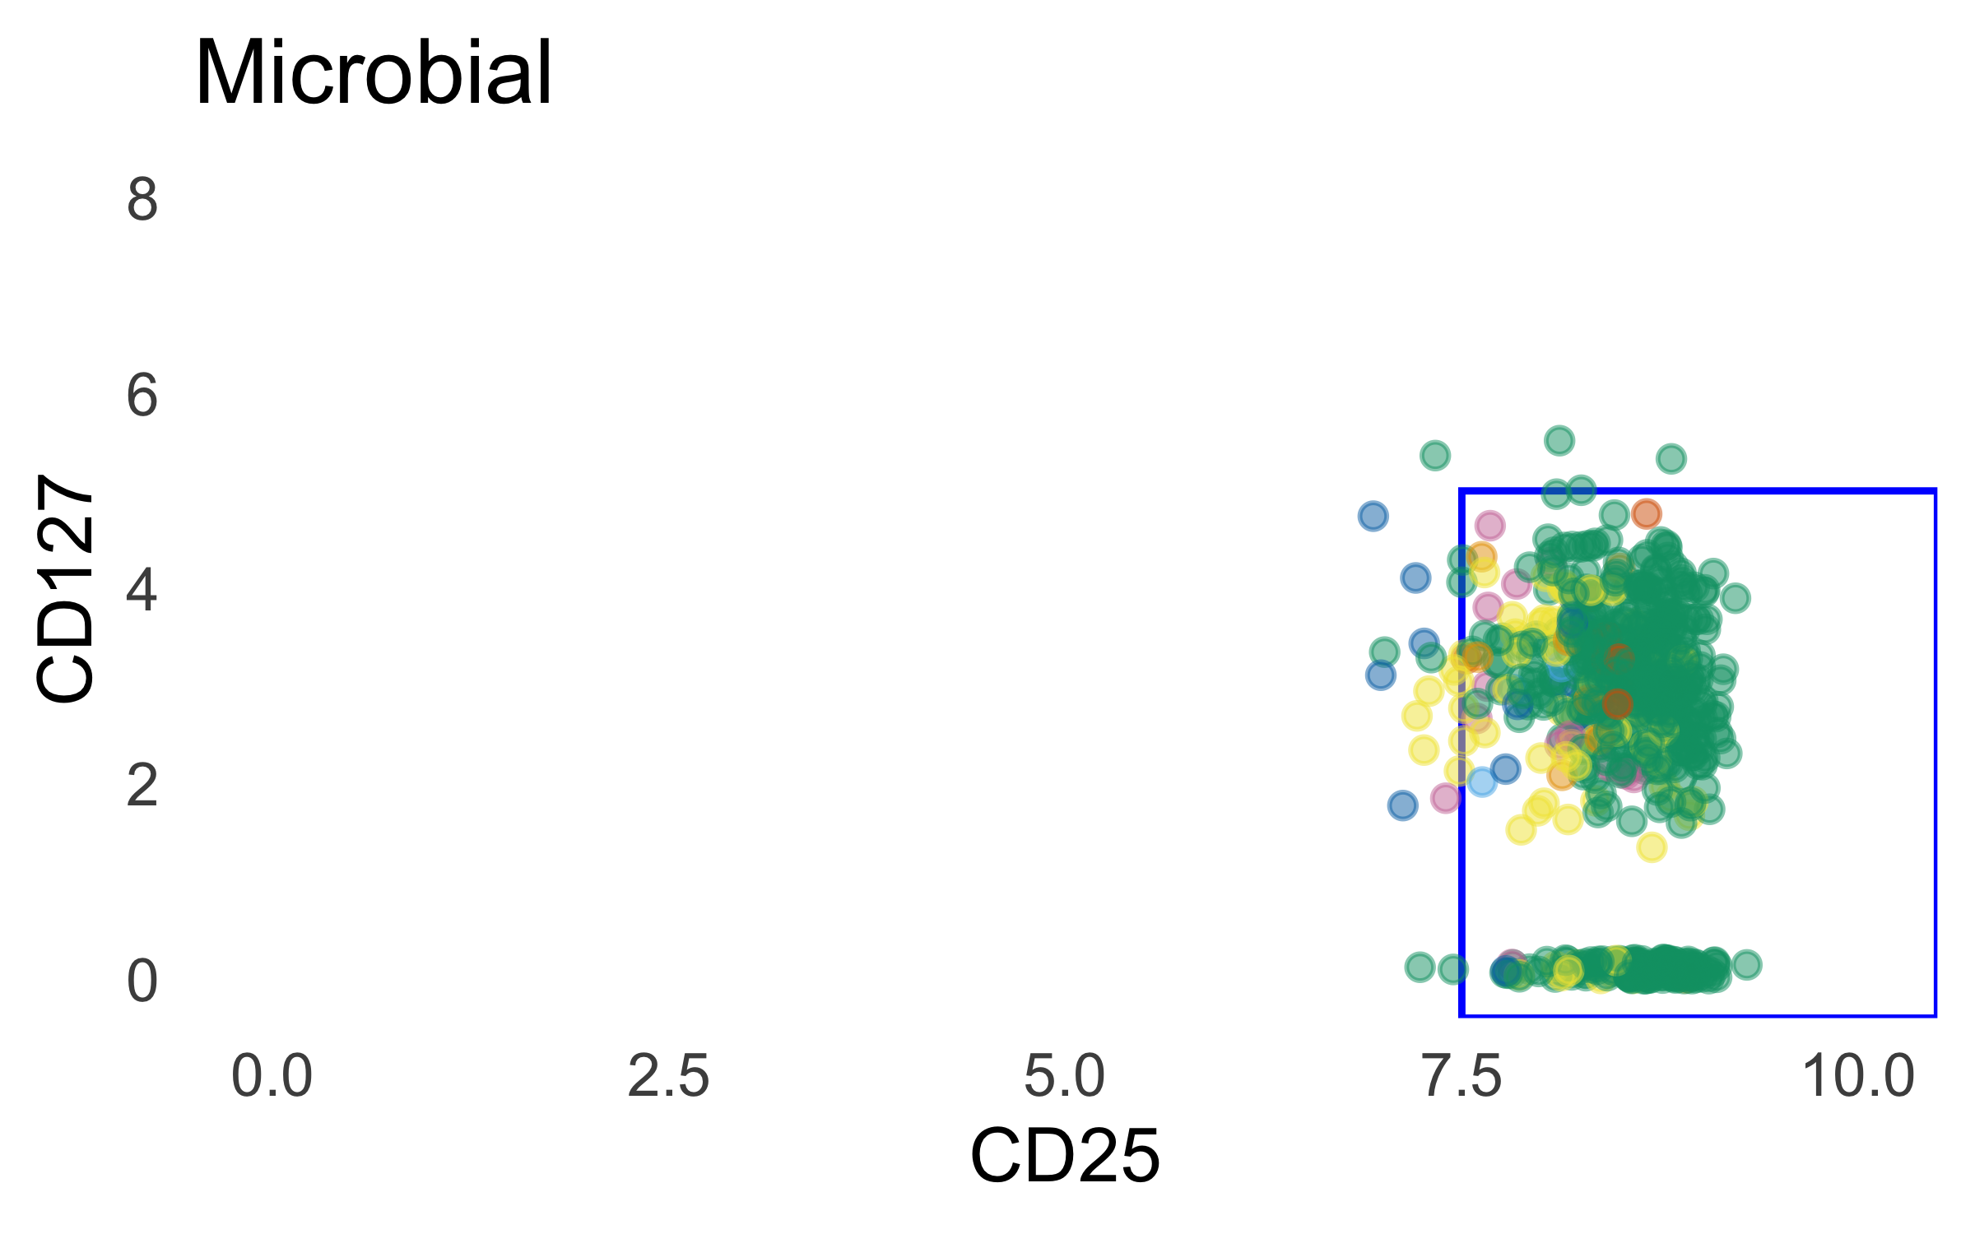
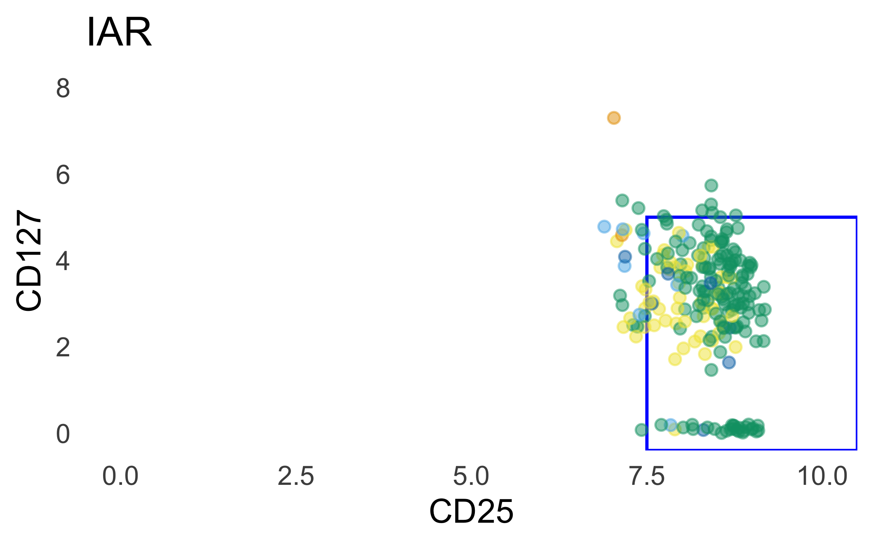
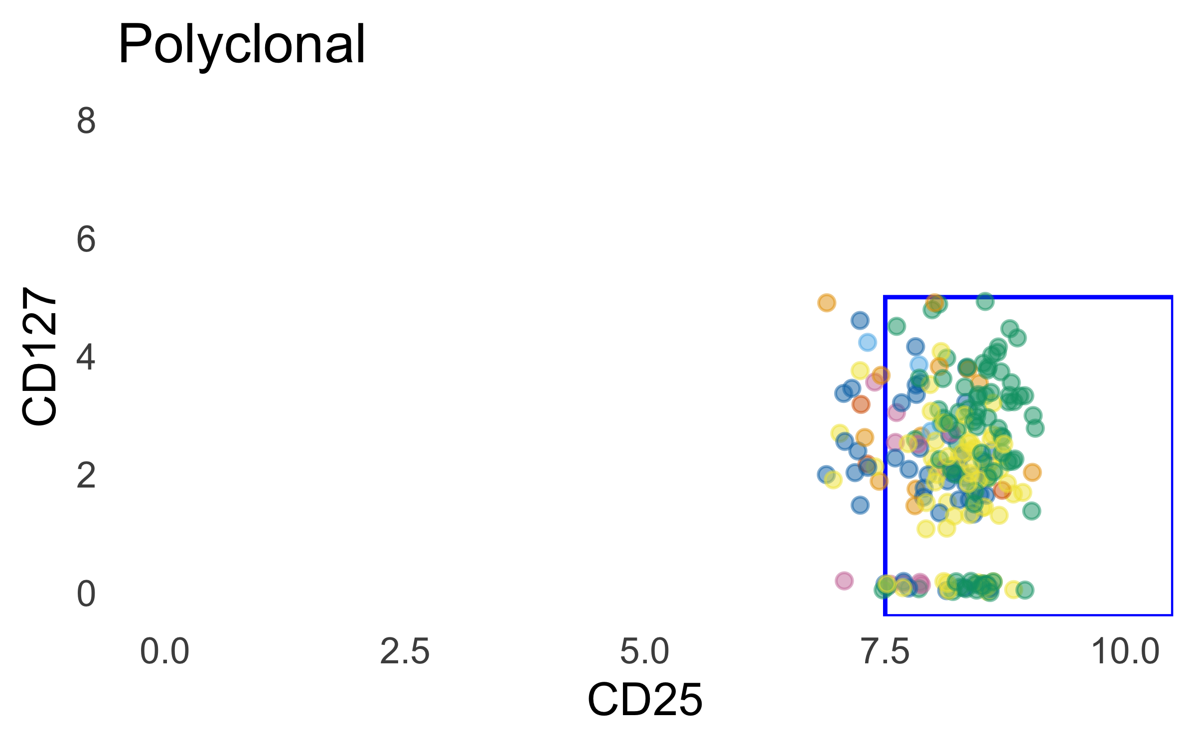
Cd127 vs cd25

Slide 10
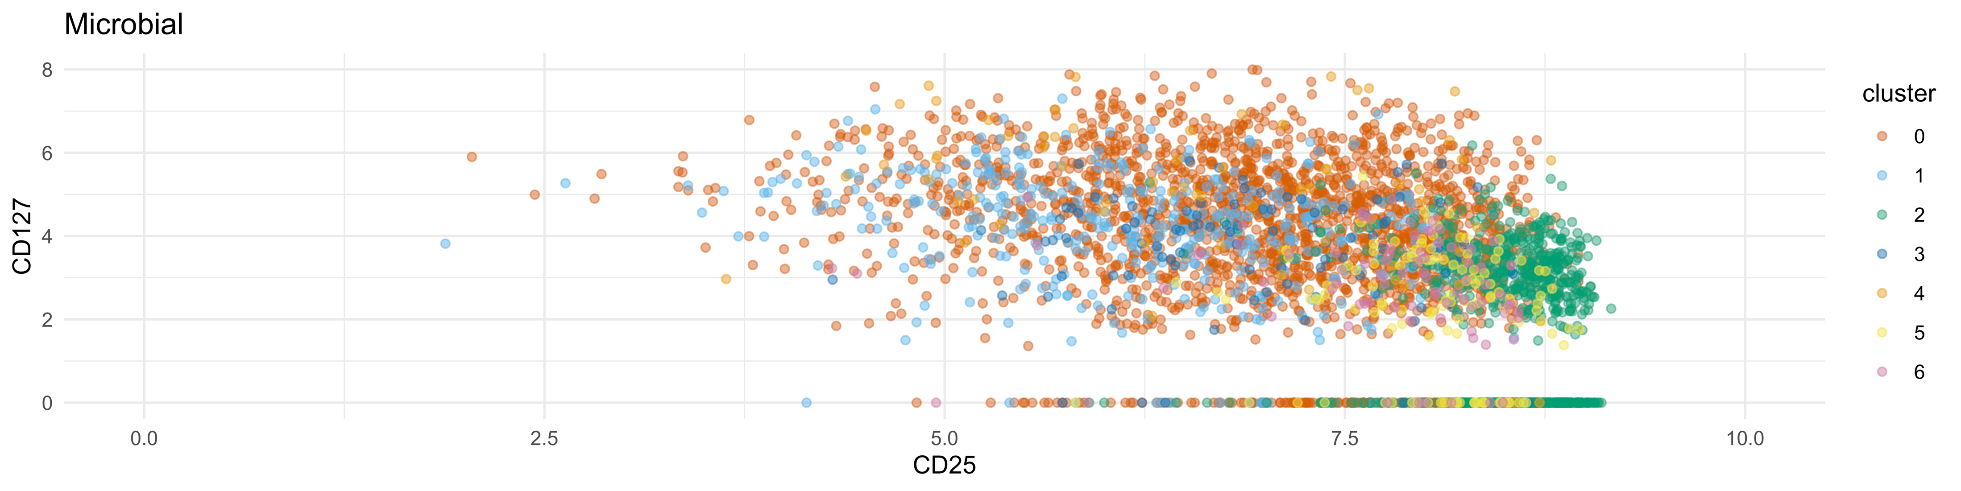
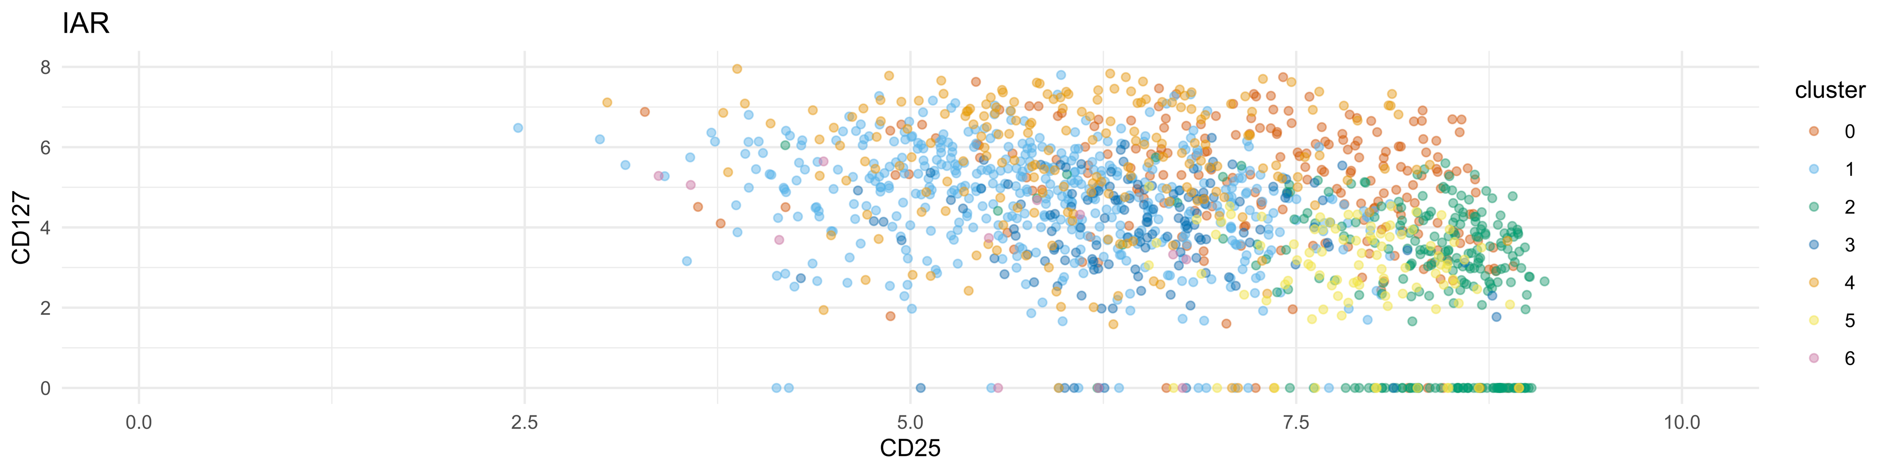
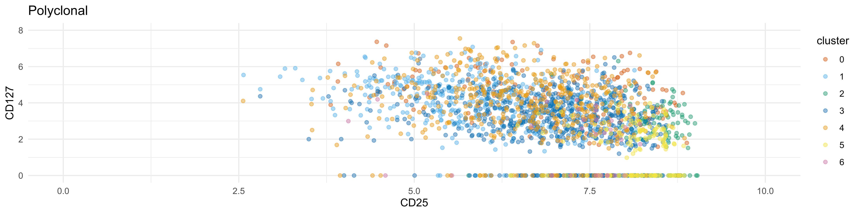
Cd127 vs cd25, ungated

Slide 11
proposed downsampling method: propensity score matching
Potential data categories for propensity score matching:
DonorId
UMI Counts
TotalSeq expression levels
Mean P390 module levels
Also next: curved gates, Stephan advising

